Slide 1

Bird Species Detection
MAJOR PROJECT – FINAL REVIEW
Department of Computer Science and Engineering Slide No: 1

Slide 2
Shri Vishnu engineering college for women::Bhimavaram (Autonomous)
BIRD SPECIES DETECTION
IV B.Tech II Sem Project power point presentation
In
Computer Science and Engineering
By
1. YERRA SANDHYA – 18B01A0589
2. MADDI KEERTHI PRIYA – 18B01A0596
3. KOTA NAGA PRIYANKA – 18B01A05A4
4. KOTA LAKSHMI PRASANNA BHAVANI – 19B05A0512
Under the guidance of
Mrs. P.R. Sudha Rani _{M.Tech(Ph.D.)}
Assoc. Professor
Department of Computer Science and Engineering Slide No: 2

Slide 3
CONTENTS
Problem Statement
System Design
Functionalities
Flow Chart
Design comparisons
System design improvements
Implementation
Technical Skills
Modules
Department of Computer Science and Engineering Slide No: 3

Slide 4
PROBLEM STATEMENT
Identifying a bird can be a challenge, even for experienced birders.
And if we are new to using field guides, it can be difficult to figure out where to even begin searching in the hundreds of pages of species.
By some features like size, shape and colour birds can be classified.
By using CNN, we can classify the species of the birds
Department of Computer Science and Engineering Slide No: 4

Slide 5
DESIGN
The human ability to recognize the birds through the images is more understandable than audio recognition. So, we have used Convolutional Neural Networks (CNN).
In our Project we created a web page such that In that page the user can upload an image so that the trained model of our project can predict the bird specie name and print the output on the web page.
We also added some features such that the bird common name is being entered on our web page and the scientific name is being printed on the web page.
Department of Computer Science and Engineering Slide No: 5

Slide 6
FUNCTIONALITIES
Our project main functionality is to predict the specie name of the bird based on the input provided by the user.
The main functionalities are:
SPECIE NAME DETECTION
COMMON NAME TO SCIENTIFIC NAME PREDICTION
FAMILY TREE
NATIONAL BIRDS
CHARACTERISTICS OF BIRD
LIFESPAN OF BIRD
Department of Computer Science and Engineering Slide No: 6

Slide 7
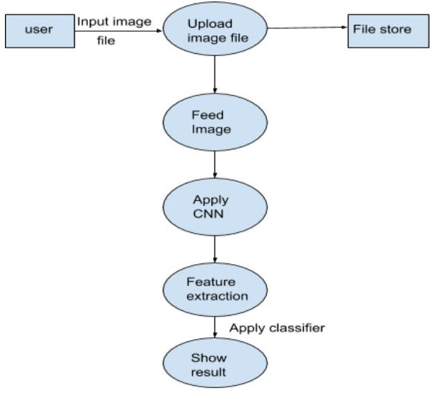
FLOW CHART
Department of Computer Science and Engineering Slide No: 7

Slide 8
DESIGN COMPARISONS
In order to identify the bird species there are many websites produces the results using different technologies.
For suppose if we will give an input in those websites and android applications it gives us multiple results instead of single bird name.
So, our aim is to develop a project to produce better and accurate results. In order to achieve this, we have used Convolutional Neural Networks to classify the bird species.
In order to achieve this we made a web application where we can upload any image of the bird so that the desired specie name is being printed .
Department of Computer Science and Engineering Slide No: 8

Slide 9
SYSTEM DESIGN IMPROVEMENTS
In Many websites the datasets that are taken into consideration are small datasets, i.e. less number of Birds Species.
Also noise images are present.
So our aim is to improve these drawbacks and achieve the better accuracy.
So for that we have used the CNN Algorithm for the better result to detect the type of species by using the image of bird.
Department of Computer Science and Engineering Slide No: 9

Slide 10
IMPLEMENTATION
The user will upload an image of the bird to the website we have created in order to predict the Bird Specie name.
Now we convert the image into greyscale by using CNN algorithm such that the image is predicted better without noise .
Noised images can cause the image to get predicted wrongly such that we will get the wrong output.
The final predicted bird’s name is being displayed on the screen.
We have also added some extra features like common to scientific name prediction ,lifespan
detection, characteristics of a bird , family tree of a bird ,national birds prediction which helps
as a guide to bird lovers.
Department of Computer Science and Engineering Slide No: 10

Slide 11
IMPLEMENTATION
Common to Scientific name prediction helps to get the scientific name of a bird which is given as an user input.
Family tree is other feature we have added to our project such that the user gets all the bird species which belong to a particular family.
National birds is another feature where in the user gets the national bird of that particular country depends on user input.
Characteristics is another feature where in the bird’s name and its features are being displayed on the web page which is given as an user input.
Life span is another feature where in the user get the bird image and the life span of that bird which is given as an user input.
Department of Computer Science and Engineering Slide No: 10

Slide 12
TECHNICAL SKILLS
Python
Machine Learning
Deep Learning
StreamLit
Department of Computer Science and Engineering Slide No: 11

Slide 13
MODULES
Bird Species Detection
Common Name to Scientific Name
Family Tree
National Birds
Characteristics of Bird
LifeSpan of Bird
Department of Computer Science and Engineering Slide No: 12

Slide 14
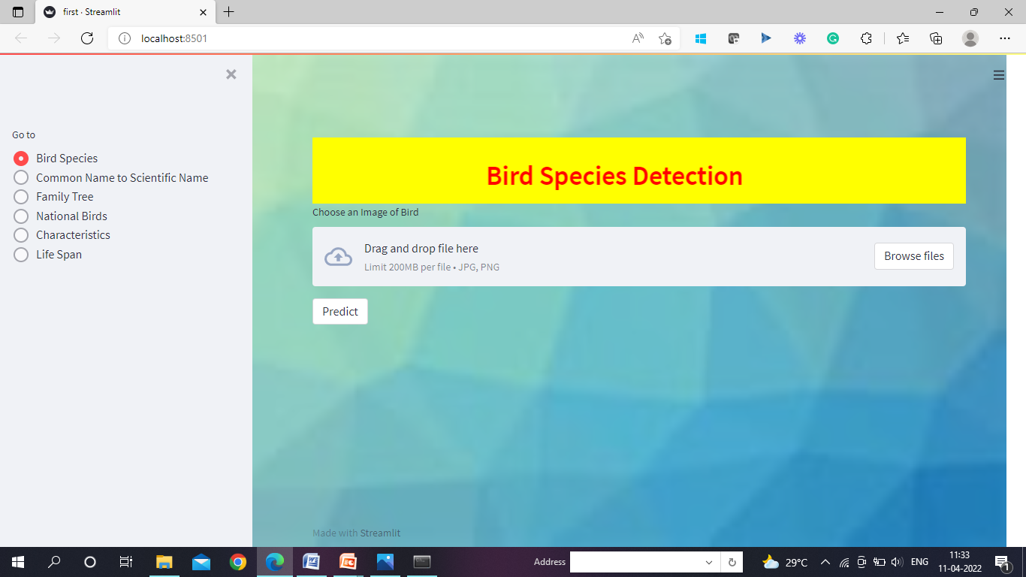
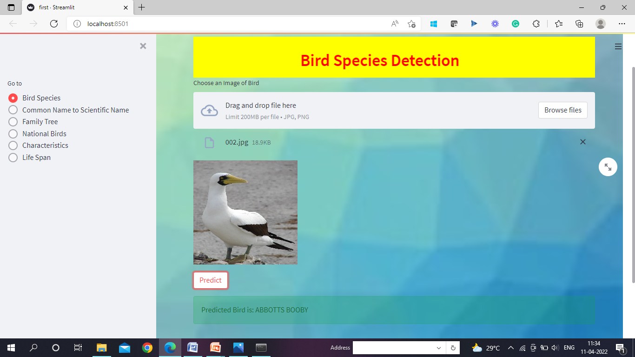
Bird Species Detection
Department of Computer Science and Engineering Slide No: 13

Slide 15
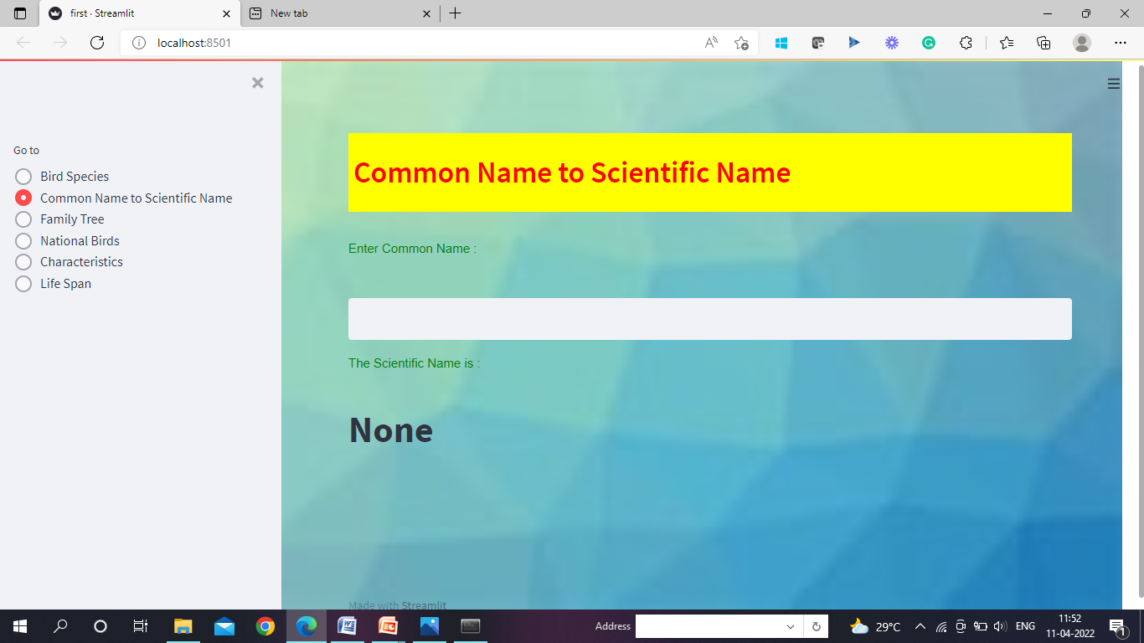
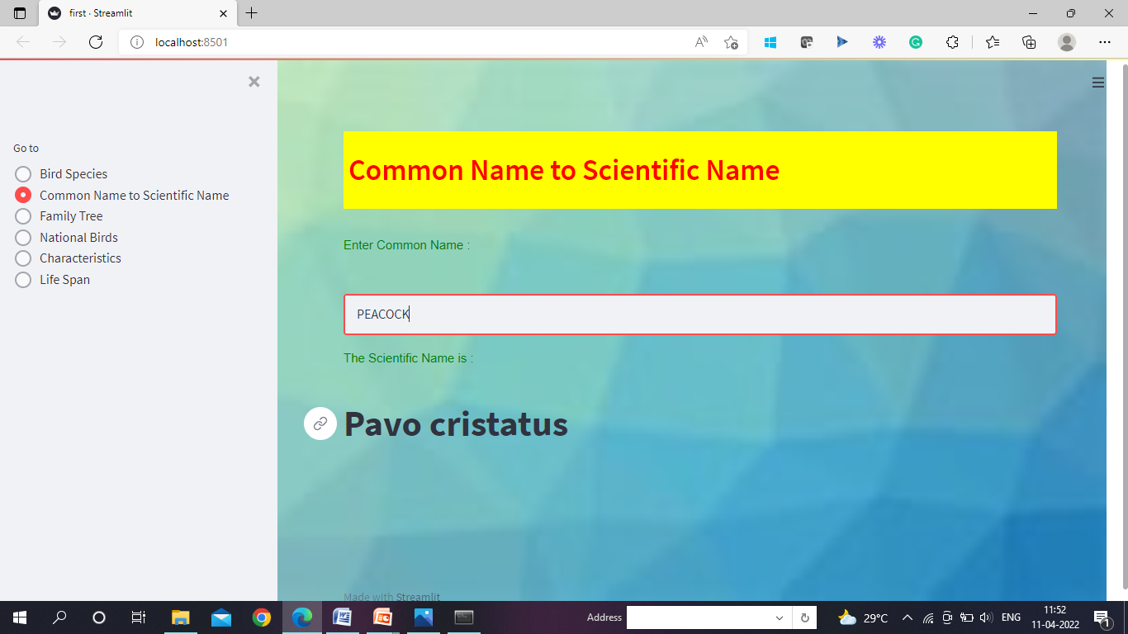
Common Name to Scientific Name
Department of Computer Science and Engineering Slide No: 14

Slide 16
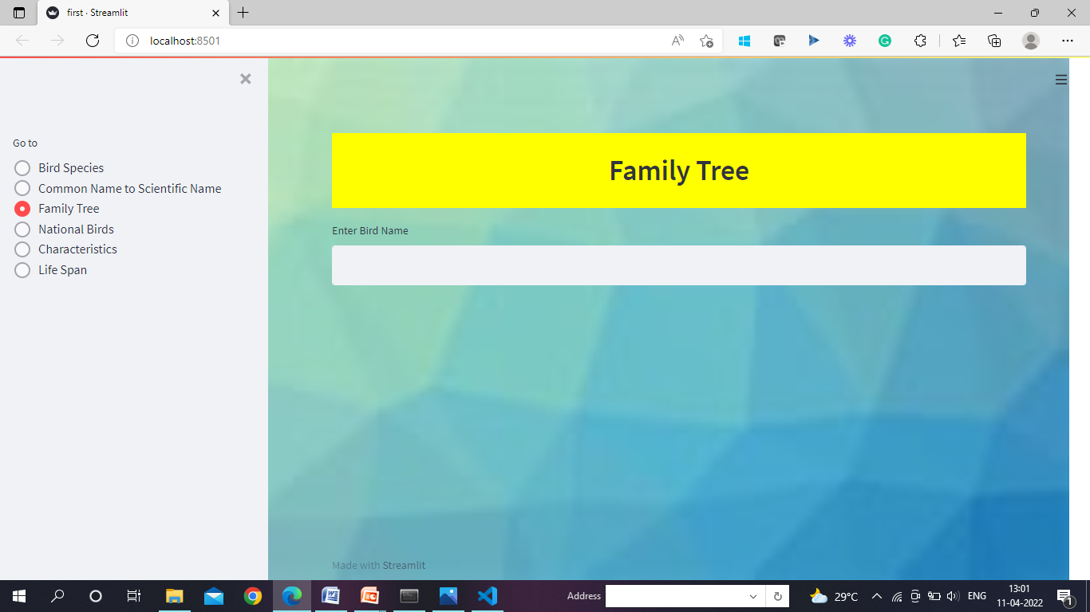
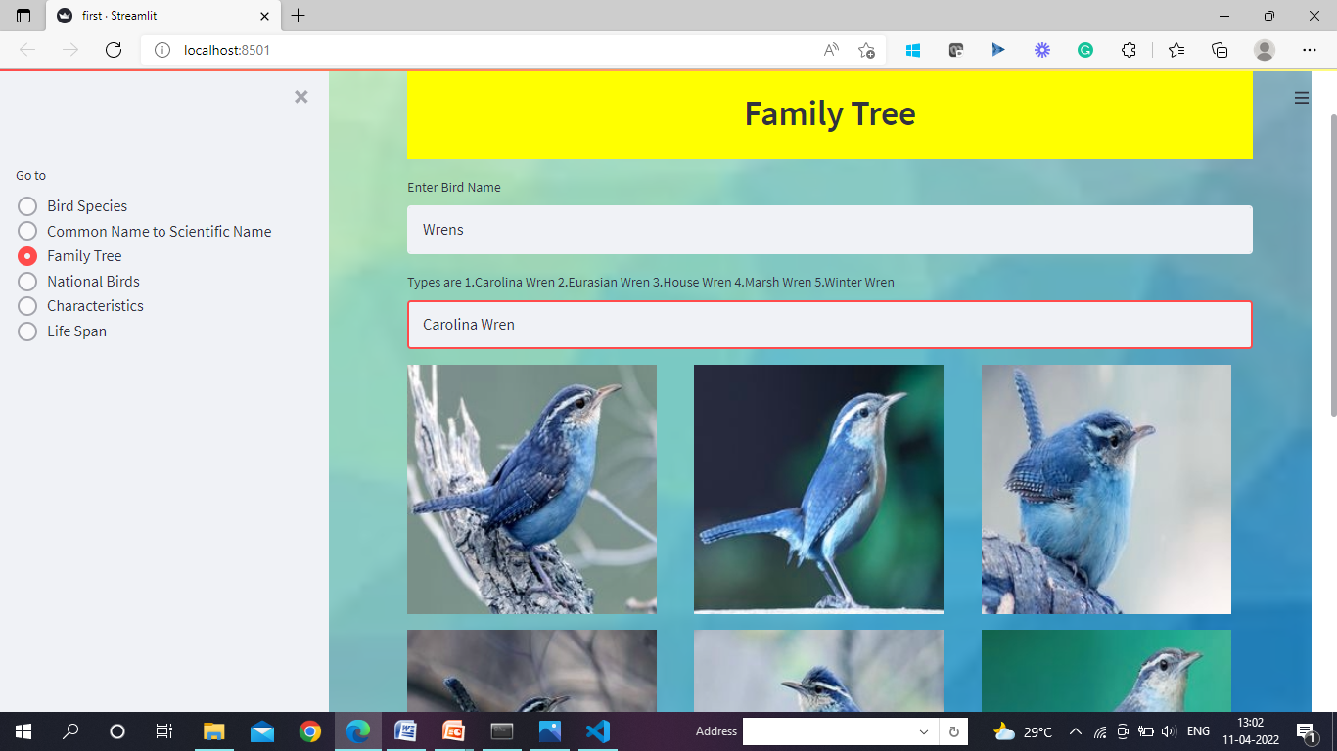
Family Tree
Department of Computer Science and Engineering Slide No: 15

Slide 17
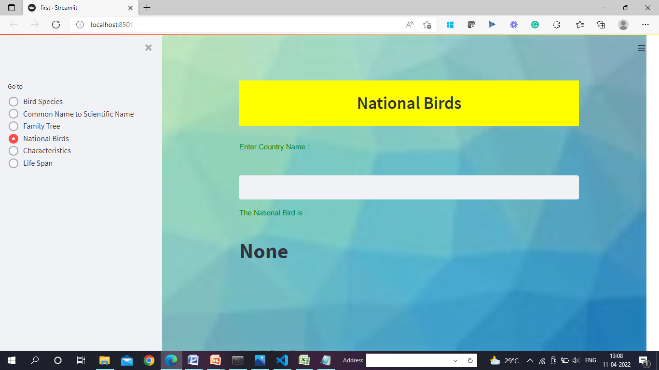

National Birds
Department of Computer Science and Engineering Slide No: 16

Slide 18
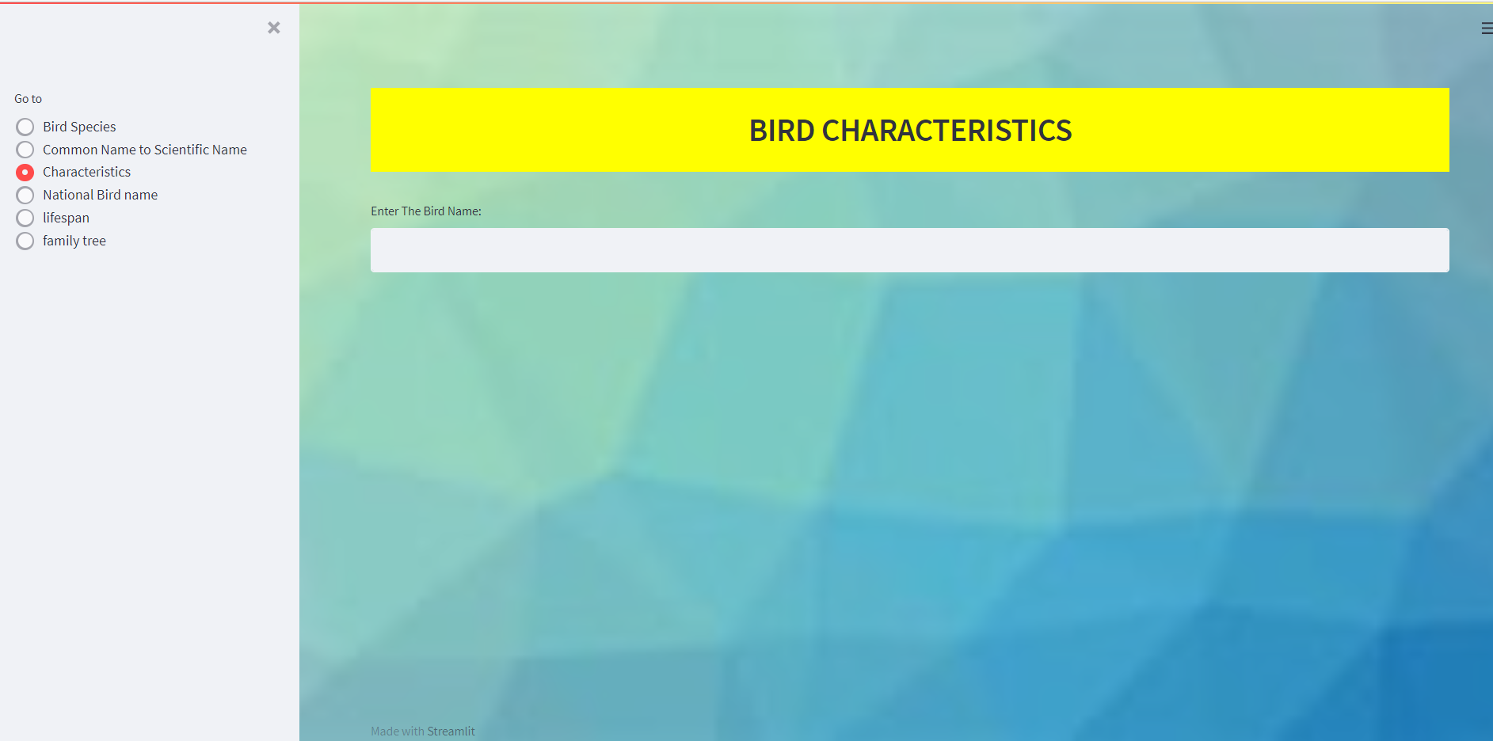
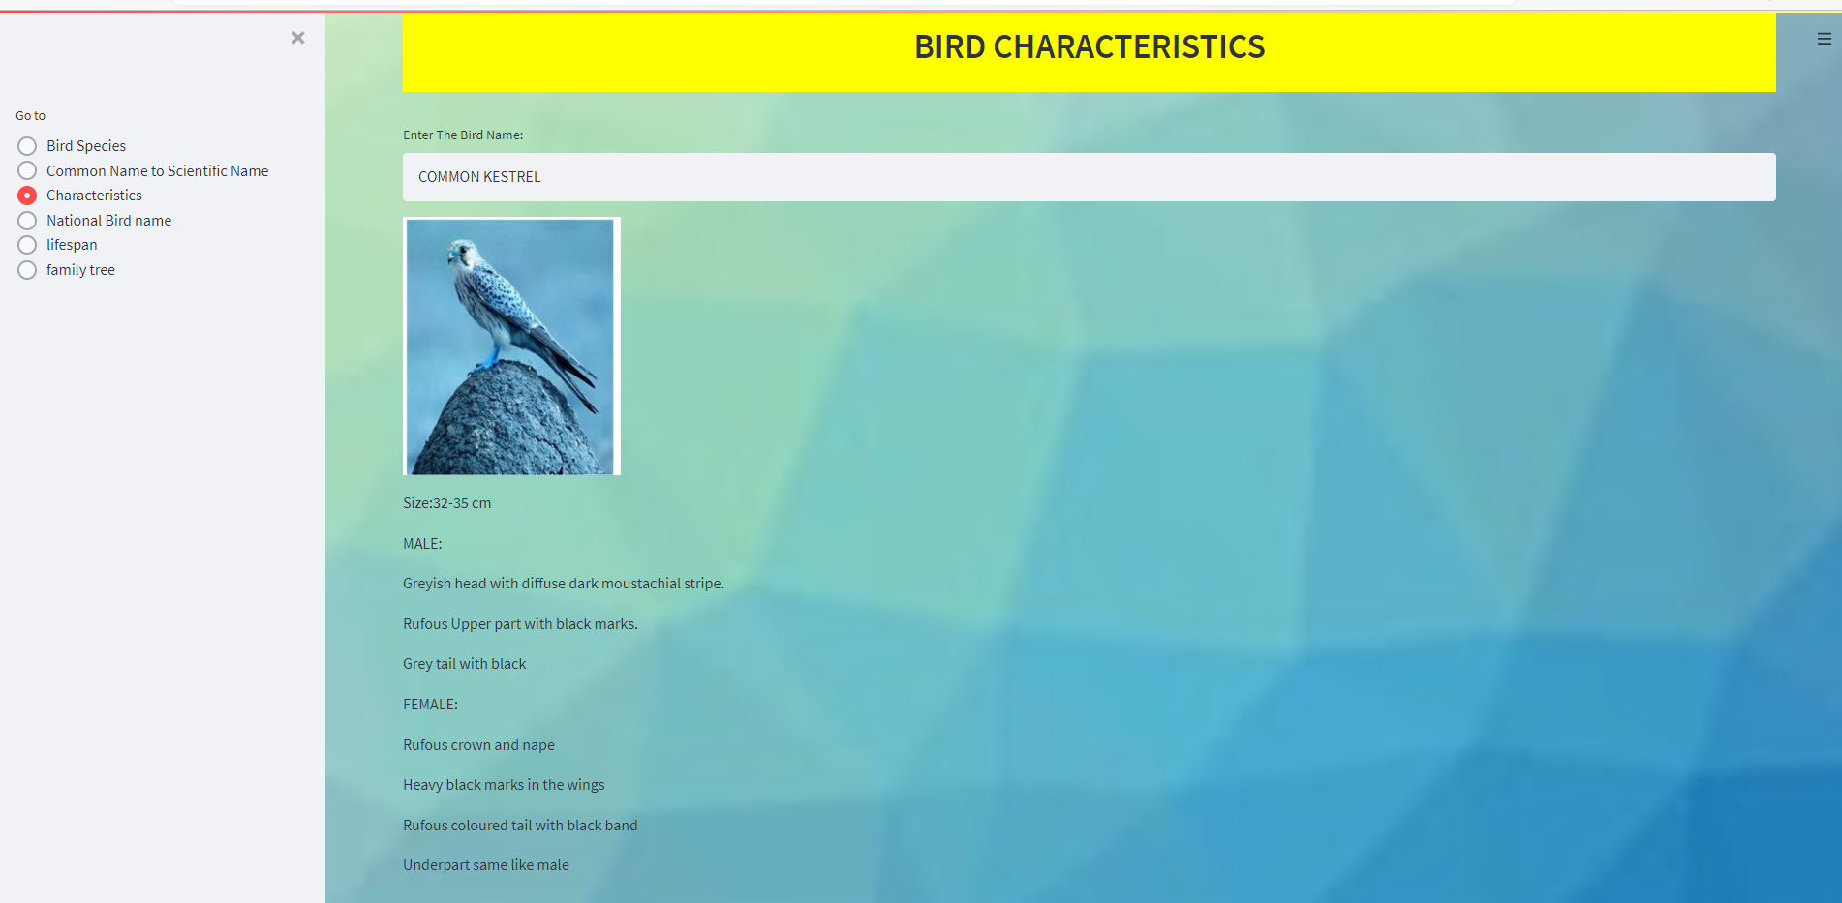
Characteristics of Bird
Department of Computer Science and Engineering Slide No: 17

Slide 19
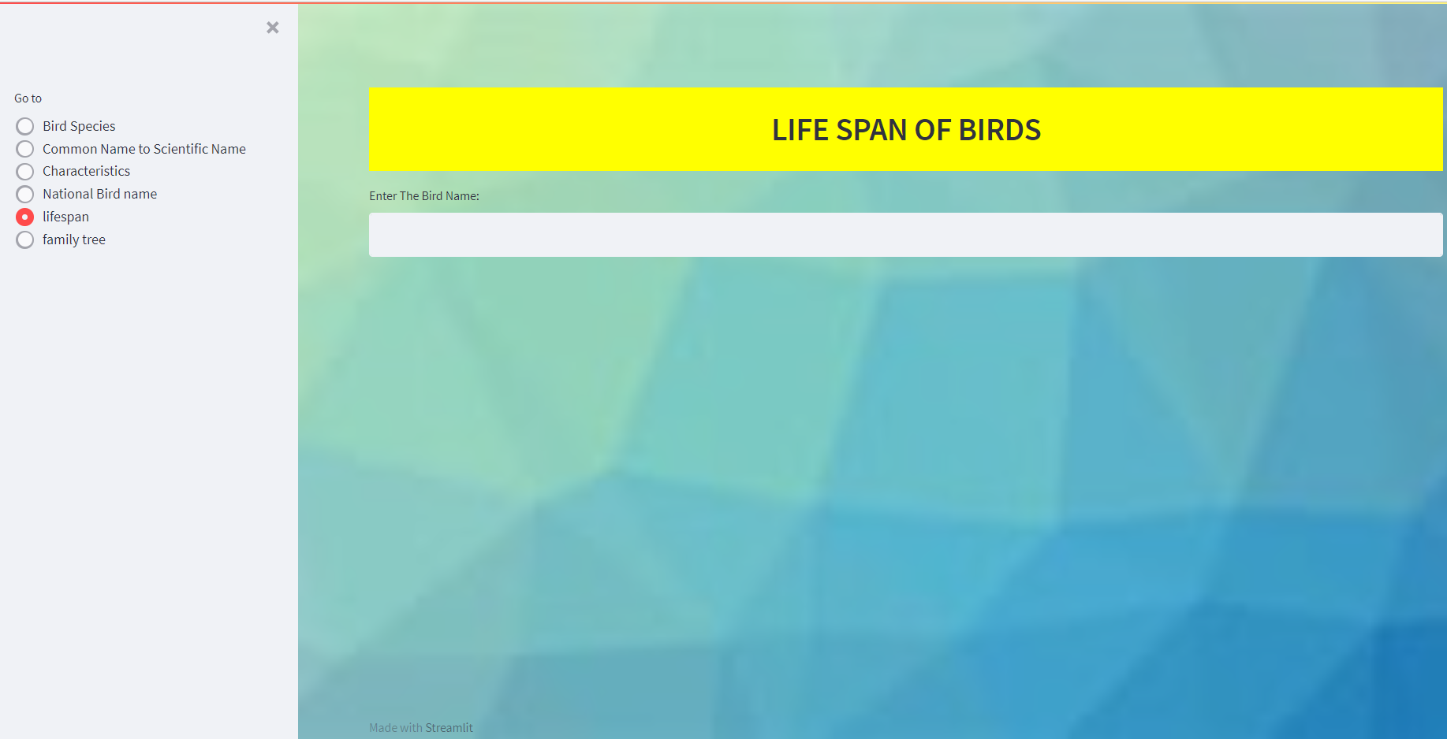
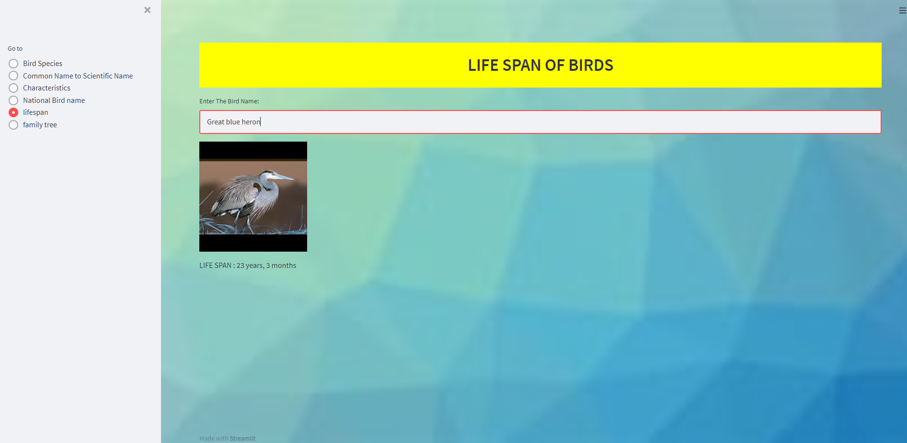
LifeSpan of Bird
Department of Computer Science and Engineering Slide No: 18

Slide 20
CONCLUSION
The main idea behind developing the identification website is to build awareness regarding bird-watching, bird and their identification, especially birds found in India.
It also caters to the need of simplifying the bird identification process and thus making bird-watching easier.
The technology used in the experimental setup is Convolutional Neural Networks (CNN). It uses feature extraction for image recognition.
The method used is good enough to extract features and classify images.
The main purpose of the project is to identify the bird species from an image given as input by the user and we can also identify the different characteristics of a Bird.
We used CNN because it is suitable for implementing advanced algorithms and gives good numerical precision accuracy.
Department of Computer Science and Engineering Slide No: 12

Slide 21
THANK YOU!
Department of Computer Science and Engineering Slide No: 19

